Slide 1
Установка github for Windows
https://desktop.github.com/

Slide 2
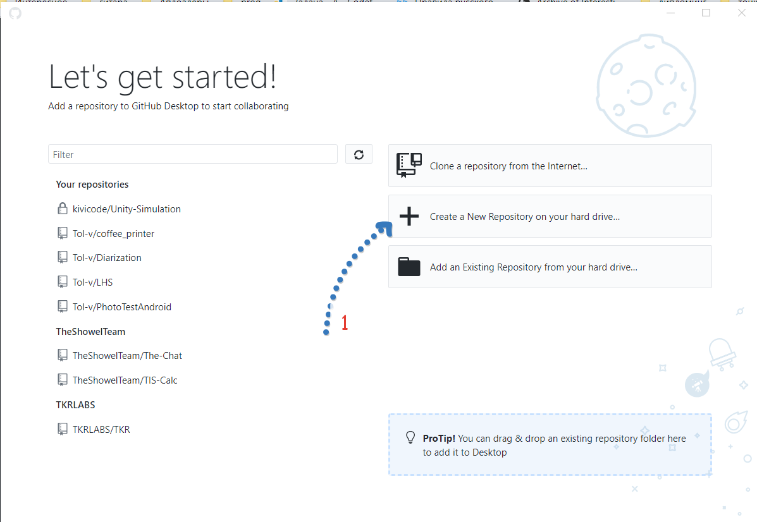

Slide 3
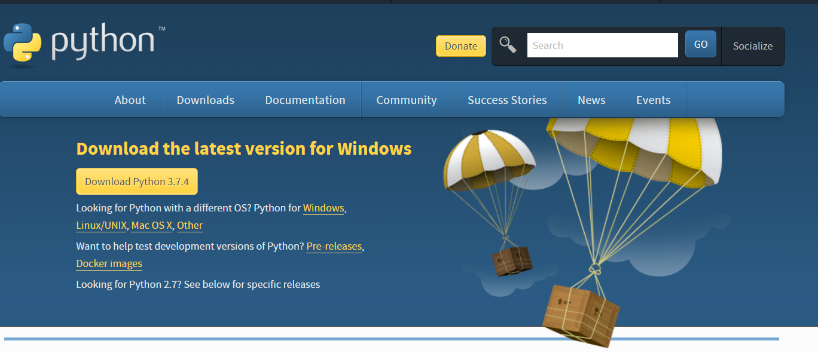
Установка python 3
https://www.python.org/downloads/

